Slide 1
List
“store its data in sequence”

Slide 2
List operations
find | Find location of a given member.
insert | Insert a new member into a given position.
findKth | Give the k^{th} member of the list.
remove | Remove a specified member from the list.
head | Give the first member of the list.
tail | Give the list after removing the first member.
append | Attach 2 lists together.

Slide 3
Implementing a List with Array
public class ListFromArray {
int[] theArray;
static final int NUMBERSLOTS = 5;
public ListFromArray() {
theArray = new int[NUMBERSLOTS];
}

Slide 4
public int find(int value) {
if(theArray == null) return -1;
for (int i = 0; i < theArray.length; i++) {
if (theArray[i] == value)
return i; // exit immediately when successfully
// finding the value.
}
return -1; // return -1 if we do not find the value.
}
O(n)
Notes:
The method find attempts to search our list (loop through our array), ending when it finds the given value (and returns the value’s position). The method can end quickly if the array is null, or if it can find value early. It can also look at every element in the array and do not find the required value at all. Therefore, its running time is $O(n)$, where $n$ is the array size.

Slide 5
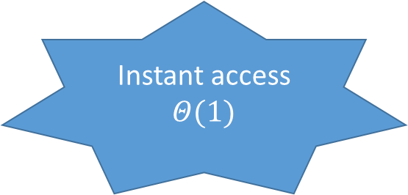
public int findKth(int kthPosition) throws Exception{
if (theArray == null ||kthPosition < 0 || kthPosition >
theArray.length - 1)
throw new Exception();// exit the method if the array does
//not exist or the position is negative or greater than
//the last possible position, throw exception.
return theArray[kthPosition];
}
Instant access $Θ(1)$
Notes:
The method findKth attempts to find the k^{th} element stored in our list. It therefore accesses our array directly to find the k^{th} member (corresponding to the k^{th} member of the list). The method generates an exception if the given position is incorrect. It can be seen that the method runs in constant time, $Θ(1)$, since it uses the array access operator to access the required array element instantly.

Slide 6
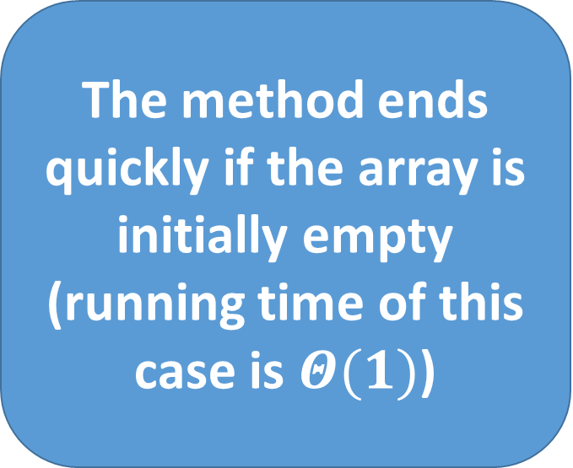
insert
public void insert(int value, int position) {
// if we have empty array
if (theArray == null) {
if (position != 0) {
return;
} else {
theArray = new int[1];
theArray[0] = value;
return;
}
}
The method ends quickly if the array is initially empty (running time of this case is $Θ(1)$)

Slide 7
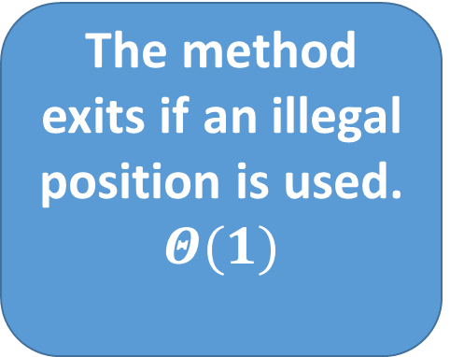
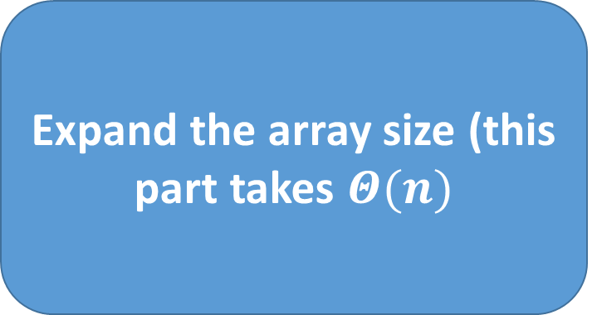
if (position < 0 || position > theArray.length - 1)
return; // exit the method if the position is
// negative or greater than the last possible
// position.
// copy contents into an expanded array(must expand).
int[] c = new int[theArray.length + 1];
for (int i = 0; i < theArray.length; i++) {
c[i] = theArray[i];
}
The method exits if an illegal position is used. $Θ(1)$
Expand the array size (this part takes $Θ(n)$

Slide 8
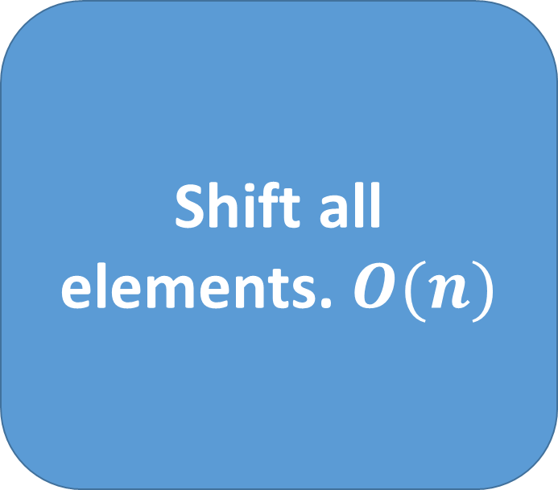
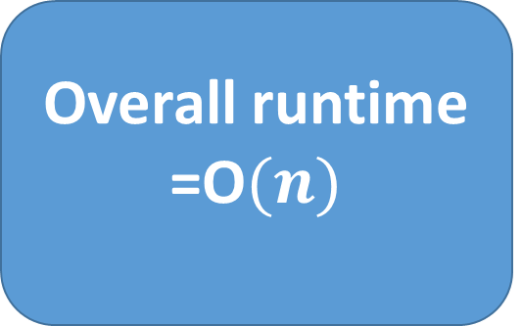
theArray = c;
// for each value from the specified position ,
// move the value to the right.
for (int i = theArray.length - 1; i >= 0; i--) {
if (i > position) {
theArray[i] = theArray[i - 1];
} else {
theArray[i] = value;
return; // return immediately after the insertion.
}
}
}
Shift all elements. $O(n)$
Overall runtime =O$(n)$
Notes:
It also has to shift all elements from the position to the right (this part takes $O(n)$ since the number of shifting elements depends on position).
The overall runtime is the result of the consecutive runtime. $O\left(n\right). ALthough Θ(n)$ is the most dominating term, the method can exit early regardless of the array size due to illegal position value.

Slide 9
Example: Inserting 6 at position 3 (previous page)
1 | 3 | 5 | 7 | 8
1 | 3 | 5 | 6 | 7 | 8

Slide 10
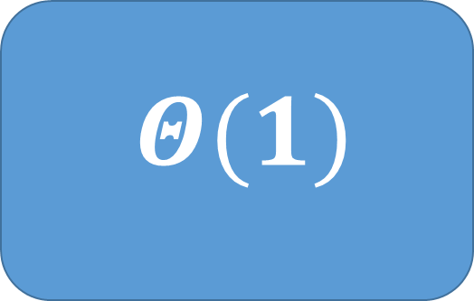
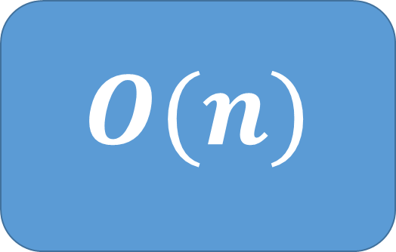
Remove
public void remove(int value)
int i;
if (theArray == null) {
return;
}
// search array for the value.
for (i = 0; i < theArray.length; i++) {
if (theArray[i] == value)
break;
}
$Θ(1)$
$O(n)$
Notes:
The program can end right away if the array is empty (nothing to be removed, $Θ(1)$). Otherwise, it has to loop in order to find value and ->

Slide 11



$Θ(1)$
if (i >= theArray.length) // if value not found..
return;
// from the position of the value we want to remove:
// if the array has one element:
if (theArray.length == 1) {
theArray = null;
return;
}
// if the array is not empty:
for (; i < theArray.length - 1; i++) {
theArray[i] = theArray[i + 1]; // shift value to the left.
}
$Θ(1)$
$O(n)$
Notes:
-> shift all data on the right-hand side of the value in the array one place to the left ($O(n)$). Since the value can be anywhere, so the loop can any number of times.

Slide 12
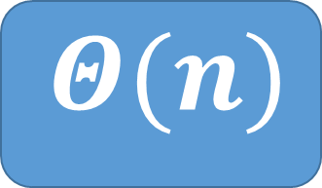

// then shrink the array.
int[] c = new int[theArray.length - 1];
for (int j = 0; j < c.length; j++) {
c[j] = theArray[j];
}
theArray = c;
}
$Θ(n)$
The overall runtime is therefore$Θ(n)$
Notes:
It also needs to shrink the array by one slot, causing a need to copy almost the entire array ($Θ(n)$). The overall running time is$Θ\left(n\right)$. Conditional exits for this method do not count as premature exits because they are for cases where array size is 0 or 1. Thus the method runtime is directly proportional to the array size. There is also a possibility that value is not in the array and the method will exit in the middle of the code, but this case requires the whole array to be searched and therefore its performance is still $Θ(n)$.

Slide 13
Example: Removing 5
i == 2
1 | 3 | 5 | 6 | 7 | 8
Shift values to the left
1 | 3 | 6 | 7 | 8 | 8
Copy to a smaller array
1 | 3 | 6 | 7 | 8 | 8

Slide 14

Head
public int head() throws Exception{
if(theArray == null)
throw new Exception();
return theArray[0];
}
$Θ(1)$
Notes:
The method head just tries to access the first member of the list, which is actually the first element of the array. Therefore it takes constant time ($Θ(1)$).

Slide 15
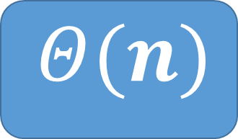
Tail
public ListFromArray tail() throws Exception{
if(theArray == null)
throw new Exception();
// create a copy because we don't want to
// change the original.
// Then just copy all except the first data.
ListFromArray l2 = new ListFromArray();
l2.theArray = new int[theArray.length-1];
for (int i = 1; i < theArray.length; i++) {
l2.theArray[i-1] = theArray[i];
}
return l2;
}
$Θ(n)$
Notes:
Method tail can end immediately if the array is empty, or it has to copy the entire array except the first data. Since the conditional exit takes place when there is no data in the array, it means that the runtime always depends on array size, without any other factors to influence it. Therefore, tail takes $Θ(n)$ to run.

Slide 16
Append
public void append(ListFromArray b) {
int thisLength = 0;
int bLength = 0;
int sumLength = 0;
if (theArray != null) {
thisLength = theArray.length;
}
if (b.theArray != null) {
bLength = b.theArray.length;
}
sumLength = thisLength + bLength;

Slide 17

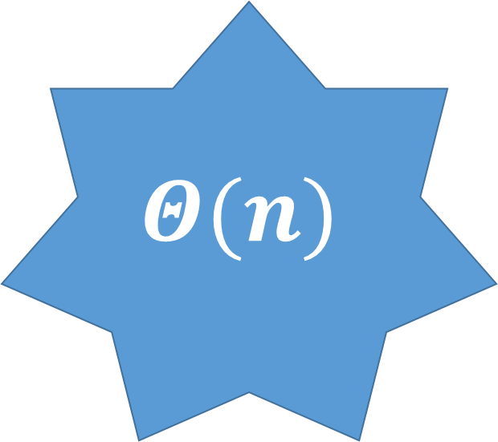

$$Θ(n)$$
if (sumLength == 0)
return;
int[] c = new int[sumLength];
int cIndex = 0;
for (int i = 0; i < thisLength; i++, cIndex++) {
c[cIndex] = theArray[i];
}
for (int j = 0; j < bLength; j++, cIndex++) {
c[cIndex] = b.theArray[j];
}
theArray = c;
}
$Θ(1)$
$Θ(n)$
Notes:
Method append returns immediately ($Θ(1)$) if both arrays we want to append do not have any content. Otherwise, contents from both arrays are copied into the resulting array, which takes $Θ(n)$ if there are n total contents from the 2 original arrays. To sum up, the running time for append is$Θ(n)$ since the conditional exit only takes place when there is no array content.

Slide 18
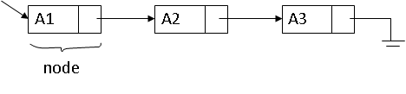
Linked List
A linked list consists of “nodes”.
Each node stores a piece of data and a link to another node, thus storing data in sequence.
Each element in a list can be reached by following links from its first node.

Slide 19
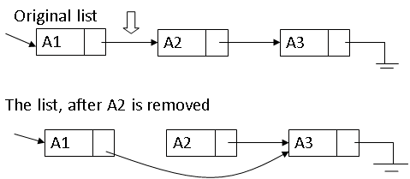
Why use a linked list?
Remove
Fast remove & insert!!

Slide 20
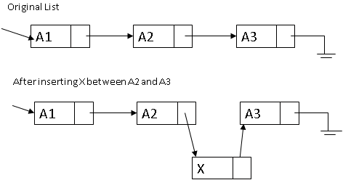
Insert
Changing a pointer from an existing node!!
Notes:
A new node containing X has to be created. Then, the link from the node that stores A2 to the node that stores A3 needs to be changed to point to the node that contains X. The link from the node that contains X is then set to point to the node that contains A3.

Slide 21
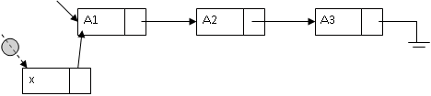
But there is a problem when inserting x a as a new first data!!!
There is no node to change a pointer from!!
Notes:
To avoid having to write a different code for this case, a header node (also called a dummy node) is introduced.

Slide 22
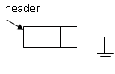
Linked list with header
header
null
General list
Empty list
Notes:
The header node does not store any data, and is always in front of the list. With the addition of a header node, every node that stores data now has a node in front. Code is therefore the same.

Slide 23
What we need to know
Node implementation.
Node marking implementation.
Linked list implementation.

Slide 24
Node Implementation
class ListNode{
int data;
ListNode nextNode;
// Constructors
ListNode(int data){
this(data, null);
}
ListNode(int data, ListNode n){
this.data = data;
nextNode = n;
}
}

Slide 25
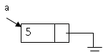
Example: ListNode a = new ListNode(5);

Slide 26
Node marking
A pointer pointing to a node we are interested in should do the job.
But it is better to find a more common interface for traversing data structures. So that programmers don’t have to remember every different way to traverse each data structure.
Hence, we use an interface called an iterator. It is a marker on one position in a data structure. It has the following operations:
hasNext(): checks if there is a next data in our data sequence.
next(): returns the next data in the sequence.
set(Type value): replace the last value returned by next() with value.
Notes:
To make it implementation-independent, every possible implementation of each data structure should implement its own iterator that has the above functionalities.
Please note that Java already has Iterator and List Iterator interface that you can use. They are different from the implementation in this course. The implementation in this course focuses on the fundamental knowledge needed to implement your own data structure from scratch, which is needed if readers want to customize a data structure of their own.

Slide 27
Iterator interface
public interface Iterator{
public boolean hasNext();
public int next() throws Exception;
public void set(int value);
}

Slide 28
List iterator implementation
public class ListIterator implements Iterator{
ListNode currentNode;
public ListIterator(ListNode n){
currentNode = n;
}
public boolean hasNext(){
return currentNode.nextNode != null;
}
A node of which data has just been returned by method next.

Slide 29
public int next() throws Exception{
//Throw exception if the next data
// does not exist.
if(!hasNext())
throw new NoSuchElementException();
currentNode = currentNode.nextNode;
return currentNode.data;
}
public void set(int value){
currentNode.data = value;
}
}

Slide 30
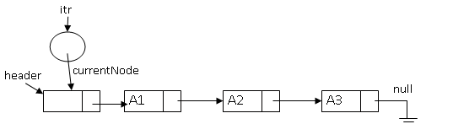
Example: iterator creation
ListIterator itr = new ListIterator(header);

Slide 31
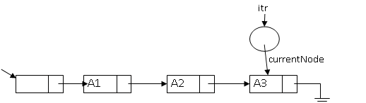
HasNext example:
Returns true
Returns false
Notes:
The method returns false when the node after currentNode does not exist.

Slide 32
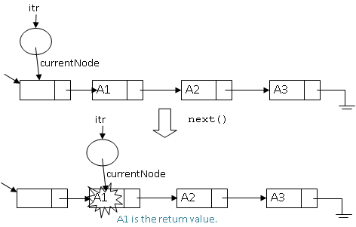
Next
Notes:
Method next creates an exception if the next data does not exist. Otherwise, it moves currentNode by one position in the list and returns the data in the node it just moves to.
The method set just straightforwardly changes the value of data in the node that we just focus on (we are not drawing it here).

Slide 33
Linked list implementation
public class LinkedList {
ListNode header;
static int HEADER_MARKER = -9999999;
public LinkedList() {
header = new ListNode(HEADER_MARKER);
}

Slide 34
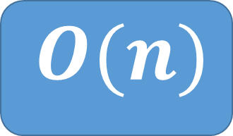
find
public int find(int value) throws Exception{
Iterator itr = new ListIterator(header);
int index = -1;
while(itr.hasNext()){
int v = itr.next();
index++;
if(v == value)
return index; //return the position of value.
}
return -1; //return -1 if the value is not in the list.
}
The method ends immediately if the linked list is empty or if the value is found.
$O(n)$
Notes:
The code for find works in exactly the same way as its array version, that is, we need to search the data structure, one data at a time. The method ends immediately if the linked list is empty or if the value is found. Therefore, its running time is the same as its array counterpart, which is $O(n)$.

Slide 35
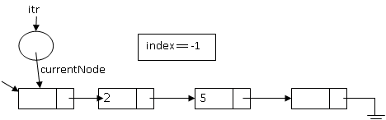
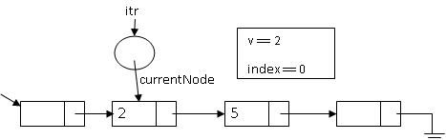
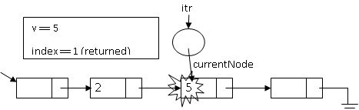
Notes:
Example : we want to search for 5.

Slide 36
findKth
public int findKth(int kthPosition) throws Exception{
if (kthPosition < 0)
throw new Exception();// exit the method if the position is
// less than the first possible
// position, throwing exception in the process.
Iterator itr = new ListIterator(header);
int index = -1;
while(itr.hasNext()){
int v = itr.next();
index++;
if(index == kthPosition)
return v;
}
throw new Exception();
}
loop can end as soon as the position is found.
$O(n)$
Notes:
Method findKth suffers from the lack of direct positional access. Therefore, it requires a loop to look for the k^{th} data in the list (its code is extremely similar to our code for find). But the loop can end as soon as the position is found. Thus its asymptotic runtime is $O(n)$. This runtime is worse than its array counterpart, but the performance increase in insert and remove outweighs this drawback.

Slide 37
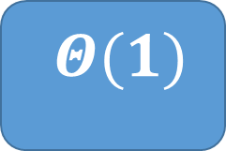
insert
$Θ(1)$
public void insert(int value, Iterator p) throws Exception {
if (p == null || !(p instanceof ListIterator))
throw new Exception();
ListIterator p2 = (ListIterator)p;
if(p2.currentNode == null)
throw new Exception();
ListNode n = new ListNode(value, p2.currentNode.nextNode);
p2.currentNode.nextNode = n;
}//
Notes:
One of the parameter is different from its array counterpart. Instead of using a position number, we use an Iterator to indicate a position before the new data. We avoid using the position number because using it requires us to iterate through the list, a very unnecessary time-consuming process. Using an Iterator to indicate a position allows our implementation to avoid any loop completely, thus reducing its asymptotic runtime to a constant value, $Θ(1)$. Please note that we have earlier seen the running time of insert for arrays, which is $O(n)$. A ListNode could also be used to indicate the position instead of an Iterator. For consistency, this class prioritizes Iterator when marking a position within a data structure.

Slide 38
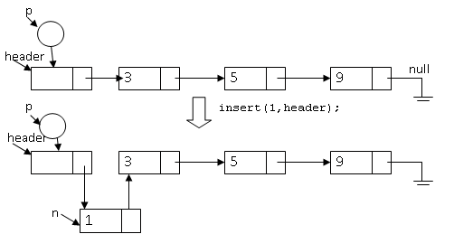
Insert to the start of the list
Insert(1,p);

Slide 39
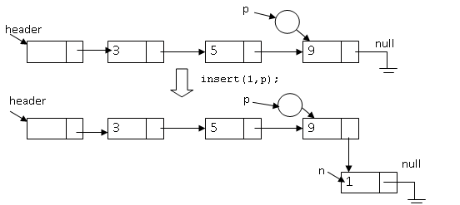
Insert to the end of the list

Slide 40

Remove
$Θ(1)$
public void remove(Iterator p){
if(p == null || !(p instanceof ListIterator))
return;
ListIterator p2 = (ListIterator)p;
if(p2.currentNode == null ||
p2.currentNode.nextNode == null)
return;
p2.currentNode.nextNode =
p2.currentNode.nextNode.nextNode;
}
public void remove(int value) throws Exception{
Iterator p = findPrevious(value);
if(p == null)
return;
remove(p);
}
Method findPrevious attempts to find a node just before the node that stores value. findPrevious returns null if no such node exists.
Notes:
Note that in the array implementation, even though we may know the position of the data to be removed, other data to the right of the to-be-removed data have to be shifted, causing the running time to still be $O(n)$.

Slide 41
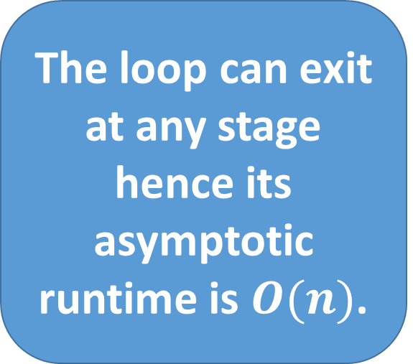
findPrevious
public Iterator findPrevious(int value) throws Exception{
Iterator itr1 = new ListIterator(header);
Iterator itr2 = new ListIterator(header);
if(!itr2.hasNext())
return null;
int currentData = itr2.next();
while(currentData != value && itr2.hasNext()){
currentData = itr2.next();
itr1.next();
}
if(currentData == value)
return itr1;
return null;
}
The loop can exit at any stage hence its asymptotic runtime is $O(n)$.
Notes:
First, two iterators are created focusing on header. Then we check if the list is an empty list by calling method hasNext. If the list is empty (method hasNext returns false), null is returned right away.
If not, we move the position of interest of itr2 by one so that the position is ahead of the position of interest of itr1.
Then we move the positions of interest of both iterators until we find value or until there is no more data to work with. If value is found, we return the position of interest ( itr1), which marks the place before the node that stores value. Otherwise, null is returned because value surely does not exist in the list.

Slide 42
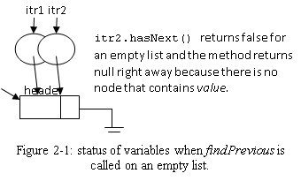
Example: findPrevious on an empty list

Slide 43
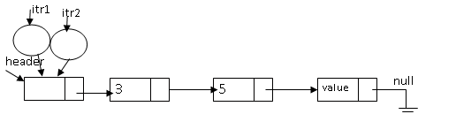
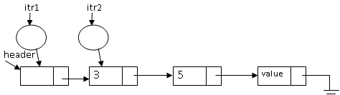
Example: findPrevious on a generic list

Slide 44
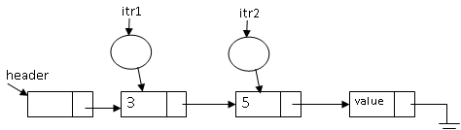
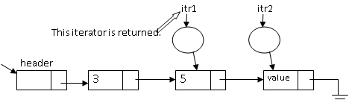

Slide 45
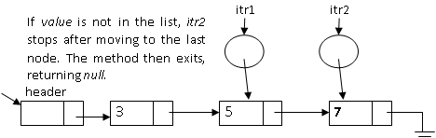
Example: findPrevious on a list that does not have the required value.

Slide 46
Head
public boolean isEmpty(){
return header.nextNode == null;
}
public void makeEmpty(){
header.nextNode = null;
}
public int head() throws Exception{
if(isEmpty())
throw new Exception();
return header.nextNode.data;
}
Notes:
We introduce isEmpty, which checks whether the list does not store any data, and makeEmpty, which disconnects the link from the header to other nodes, effectively make the list become empty.
Method head is straightforward. It just tries to return data in the node next to header. So it runs in constant time just like its array counterpart.

Slide 47



Tail
public LinkedList tail() throws Exception{
if(isEmpty())
throw new Exception();
// Copy everything except the first data to the new list.
LinkedList list2 = new LinkedList();
Iterator p1 = new ListIterator(header.nextNode);
Iterator p2 = new ListIterator(list2.header);
while(p1.hasNext()){
int data = p1.next();
list2.insert(data,p2);
p2.next();
}
return list2;
}
$Θ(1)$
$Θ(n)$
$Θ(n)$
Notes:
Method tail exits immediately if the list is empty. Otherwise it uses a loop to copy data (except the first data) to a new list and return that list. The number of iterations is directly proportional to the size of the list. So its asymptotic runtime is $Θ(n)$. Although the method can exit early, it does so due to the size of the list being zero. Therefore, all depends on the list size.
If we allow our original list to change, the method can simply remove the first data and take constant time. But here we do not want method tail to change our original list.

Slide 48

Append
public void append(LinkedList list2) throws Exception{
Iterator p1 = new ListIterator(header);
Iterator p2 = new ListIterator(list2.header);
//move iterator to the end of our list.
while(p1.hasNext())
p1.next();
//then copy everything from list2 to our list.
while(p2.hasNext()){
insert(p2.next(),p1);
p1.next();
}
}
$Θ(n)$
Notes:
Method append enters loops n times, where n is the total amount of data from both lists. Therefore, its asymptotic runtime is $Θ(n)$, just like its array counterpart.

Slide 49
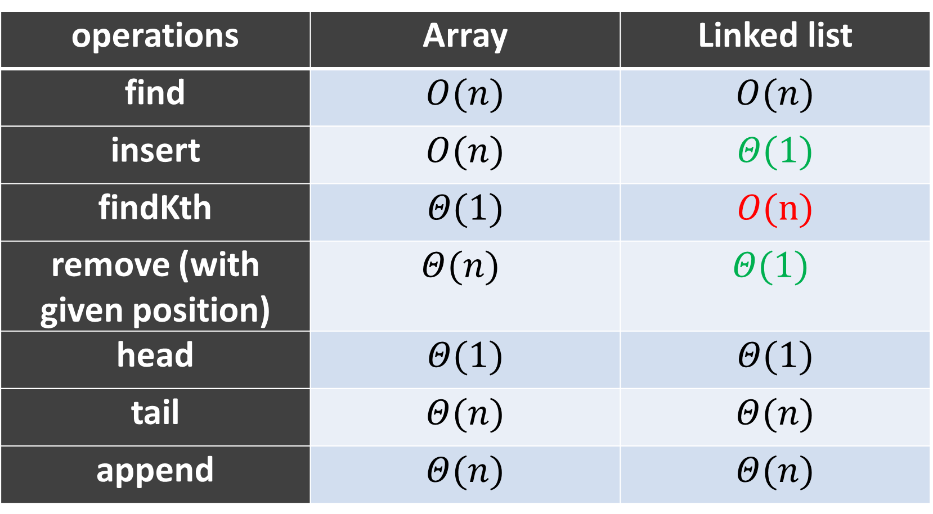
Summary of runtime comparisons
operations | Array | Linked list
find | $$O(n)$$ | $$O(n)$$
insert | $$O(n)$$ | $$Θ(1)$$
findKth | $$Θ(1)$$ | $$O(n)$$
remove (with given position) | $$Θ(n)$$ | $$Θ(1)$$
head | $$Θ(1)$$ | $$Θ(1)$$
tail | $$Θ(n)$$ | $$Θ(n)$$
append | $$Θ(n)$$ | $$Θ(n)$$

